Slide 1

Welcome
to

Slide 2


Slide 3

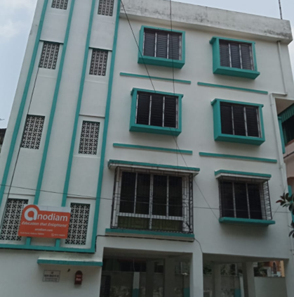
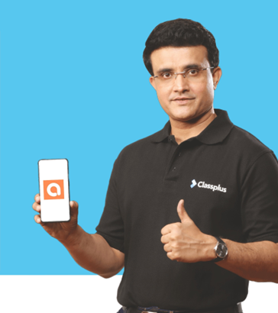

And
© PROTECTED ANODIAM 2023 || PRIVATE & CONFIDENTIAL

Slide 4
Swim Lanes
Tech
Commerce
Law
NEET/IIT
VIII to XII Science
Humanities
Professional Courses
Junior Section
Competitive
Co Curricular
© PROTECTED ANODIAM 2023 || PRIVATE & CONFIDENTIAL

Slide 5









AI HAS TAKEN THE WORLD BY STORM!

Slide 6

EVERY COMPANY WILL BE A DATA COMPANY IN FUTURE

Slide 7


DATA IS A SUPERPOWER
WITH GREAT POWER COMES GREAT RESPONSIBILITY!

Slide 8
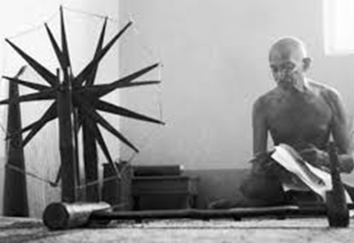
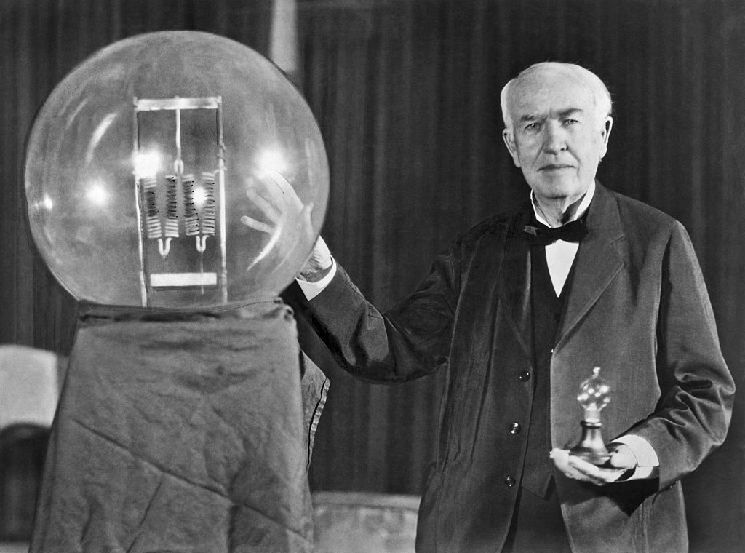
Empathy and Innovation
And
© PROTECTED ANODIAM 2023 || PRIVATE & CONFIDENTIAL

Slide 9

AI & Robotics
Make India
an AI
Super Power
IoT, Robotics
& AI Study
nodiam, Education that enlightens!
Dependable Competency Partners
Expert Industry Veterans
Lucid & Practical
IT
Competency
Scientific
Knowledge

Slide 10
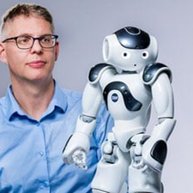
A Brave New World
Mundane Professions to Phase Out
Basic office jobs: Accountants, clerks, tellers, junior lawyers
Junior software & web dev, BPOs, telemarketing & data entry
Basic content writers, proofreaders & graphic designers
Farming, security, factory workers & assembly line
Packagers, drivers, warehousing workers, delivery workers
Experts To Need More AI Skills
Healthcare: Doctors, surgeons, therapists, technicians
Teachers & educationists
Scientists & researchers
Software developers, trade's people, technicians & artists
Corporate strategists, social workers & lawyers
Creative & Innovative Professions To Be In
Artificial intelligence & Machine learning engineers
Data engineers & data scientists
IoT specialists & robotics engineers
Senior software engineers
A.I. – more profound than fire or electricity!
- Sundar Pichai, Alphabet C.E.O.

Slide 11

nodiam’s Professional Competencies
nodiam’s mission is to mentor school children into leading edge technologies because children’s appreciation for technology today, will make India the leader of tomorrow. We are pleased to join hands with elite schools like Loreto, Elliot St. in this journey.
Our globally industry leading coaches are specialists in:
Comprehensive teaching of CICSE Robotics & AI syllabus
Python computing skills & all relevant libraries
Data Science, AI, Analytics & Data Visualization
Computer Vision & NLP
IoT & Robotics
Cyber Security
Hands-on labs & project-based mentoring
Support beyond syllabus & instil knack for career excelling
Impart awareness of ethical considerations
Accurate skill assessment of students in the above areas

Slide 12

Welcome!
© PROTECTED ANODIAM 2023 || PRIVATE & CONFIDENTIAL

